Slide 1
INTERIOR PREMIUM WALL PAINT

Slide 2
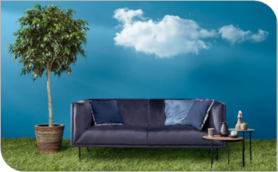
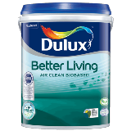
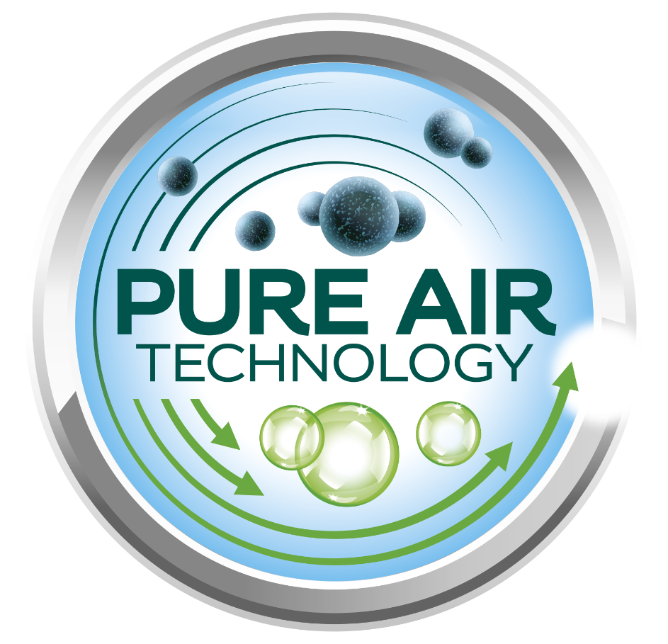
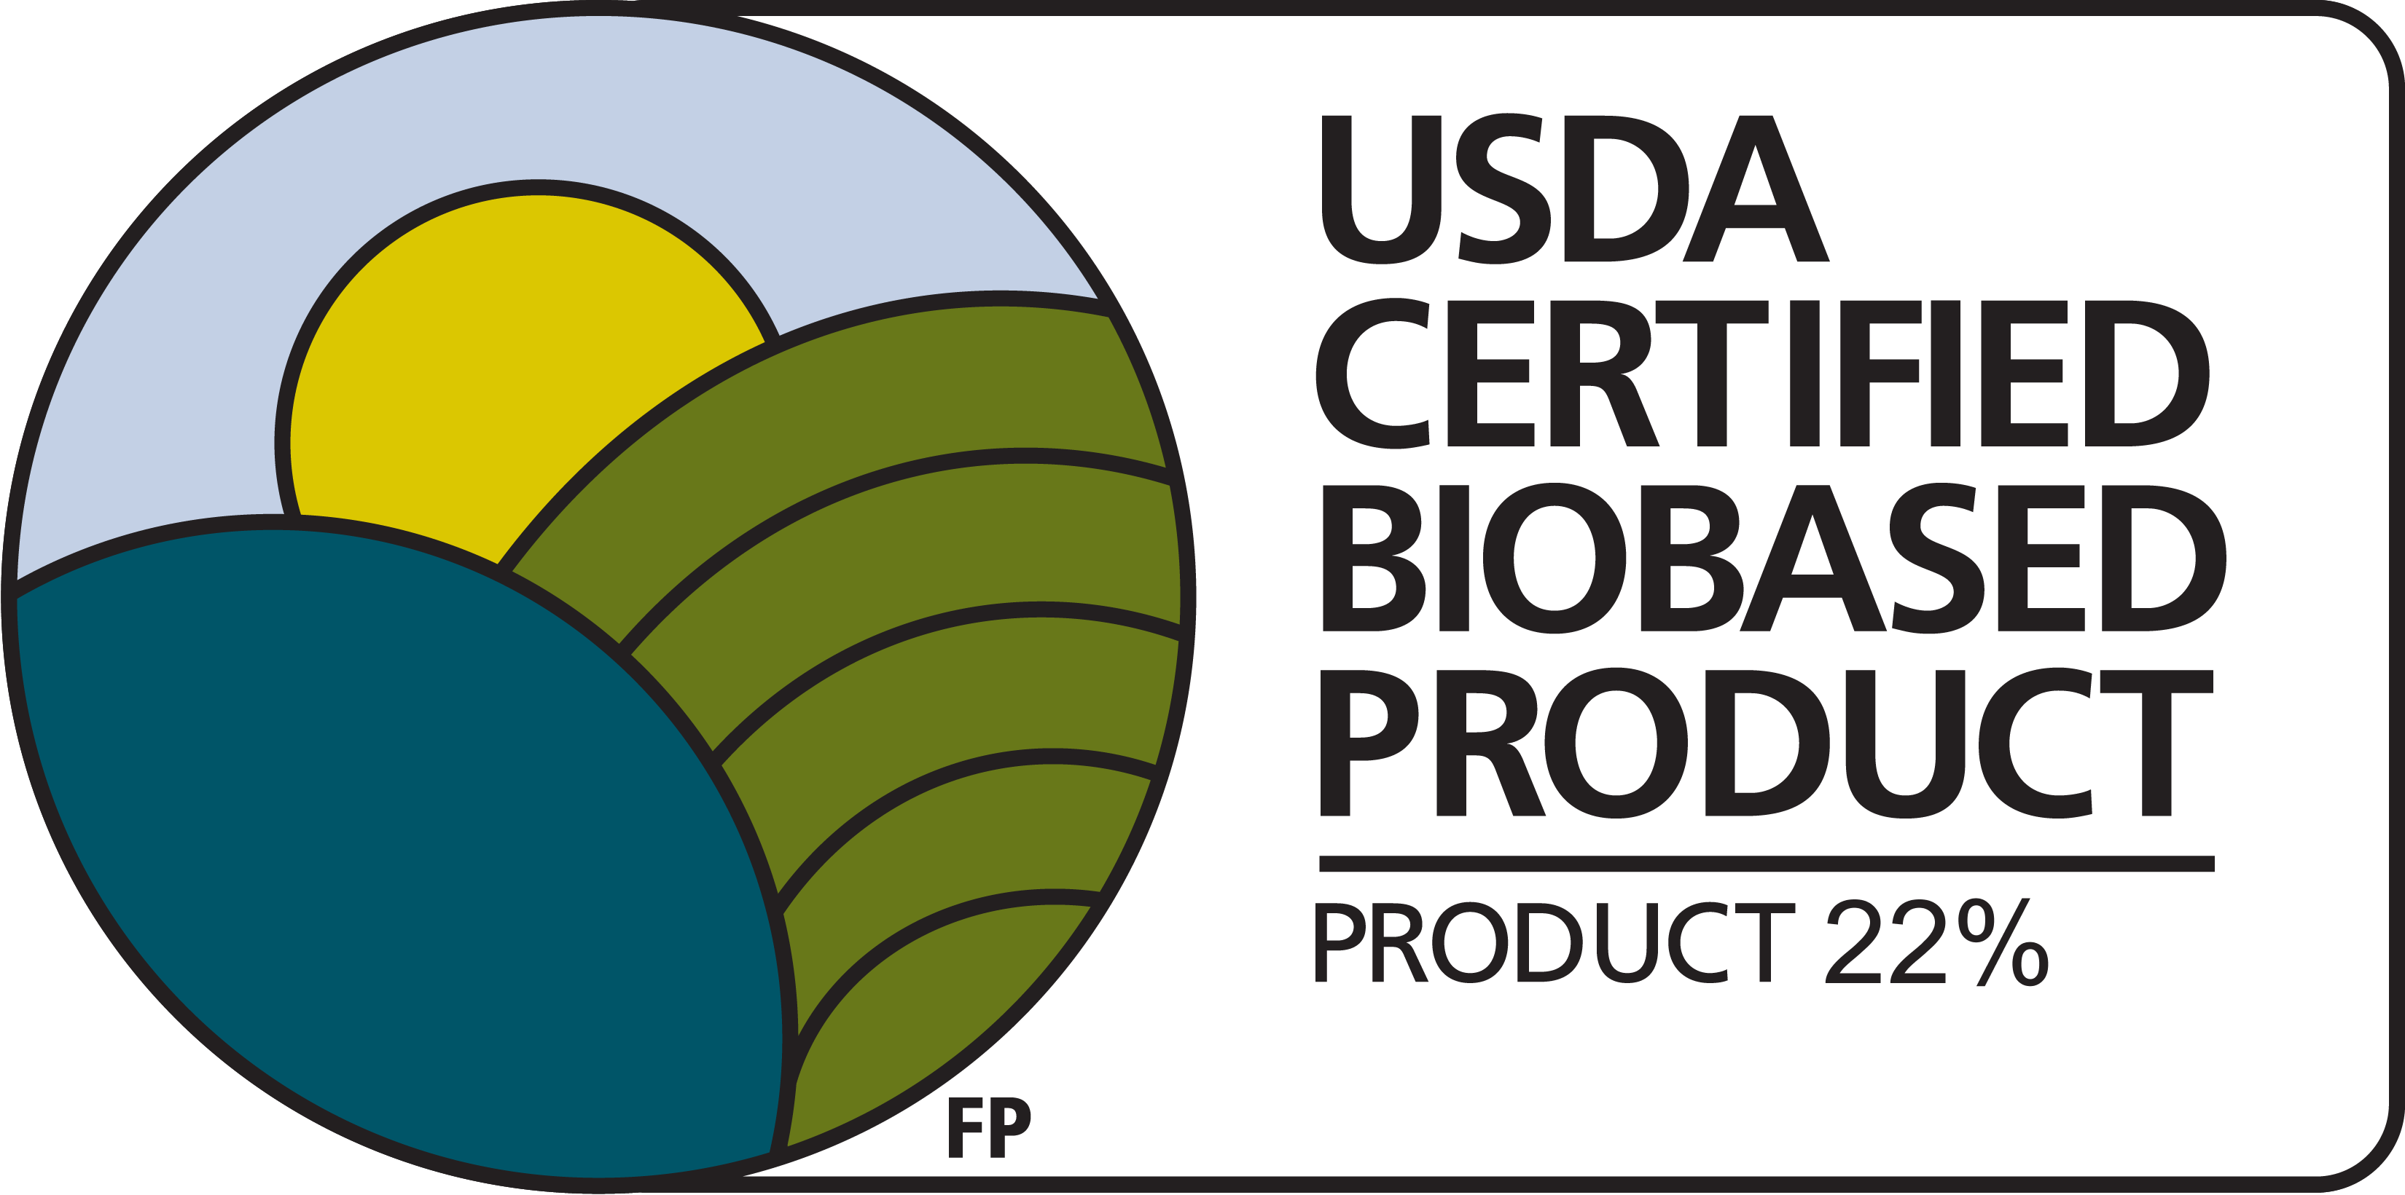


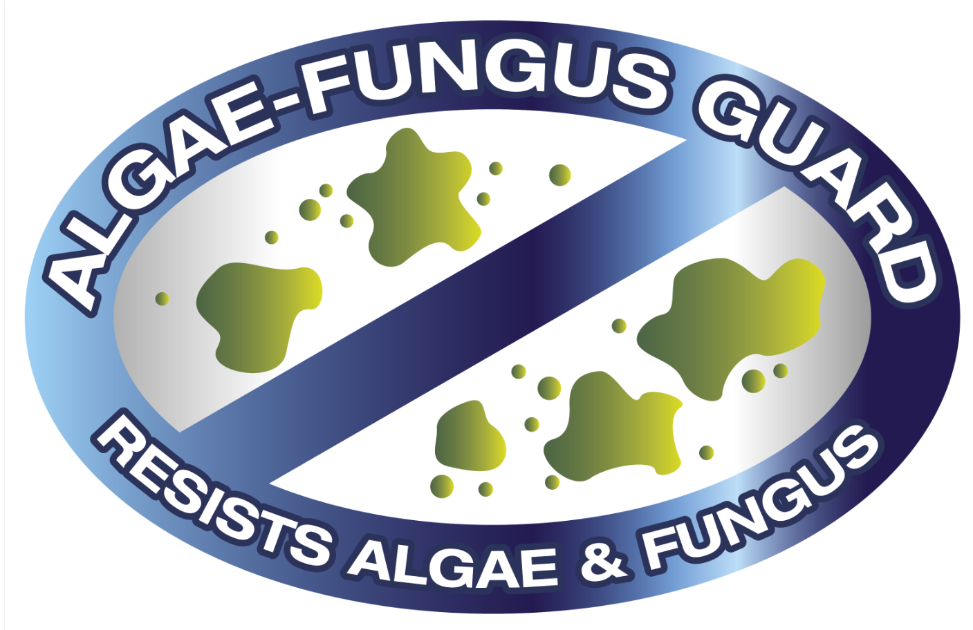
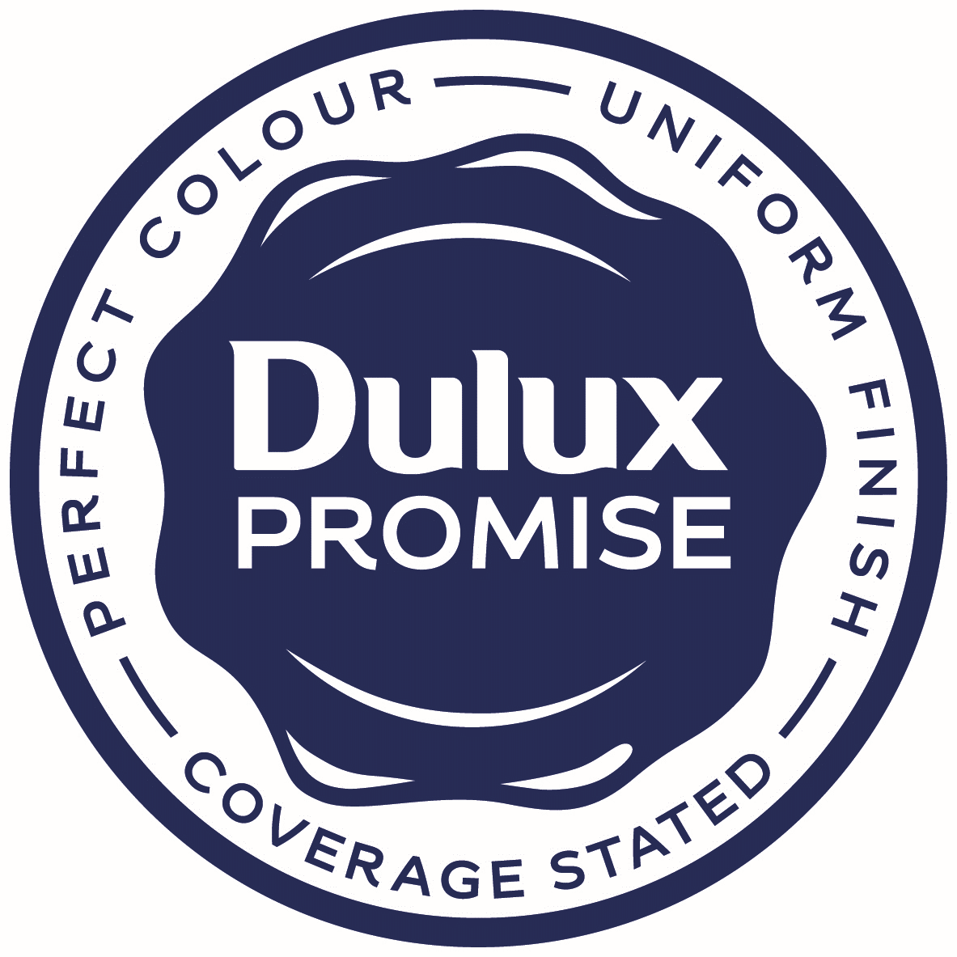

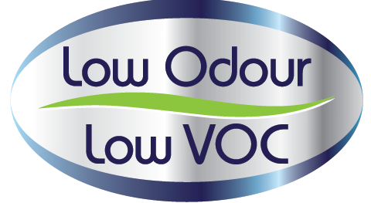
Dulux Better Living Air Clean Biobased
Problem Statement
Our homes are unhealthier environments than we realize. As our lives are being spent increasingly indoors, we want to feel the therapeutic benefits of nature inside our homes too
Solution
Dulux Better Living with unique PureAir technology and biobased ingredients, purifies indoor air, by reducing the harmful impact of formaldehyde and other VOCs
Benefits
Cleaner Air, that promotes healthier living and USDA-certified paint that’s better for environment, due to use of natural bio-based ingredients such as active bamboo charcoal.
Available in
1L, 5L
Product Features
Water/Solvent | Water-based
Finish | Sheen
Coverage | 11-12 m²/L
Drying time | 2-3 hours
Colour Availability | Soft & Pastel colours, >1,200 colours

Slide 3
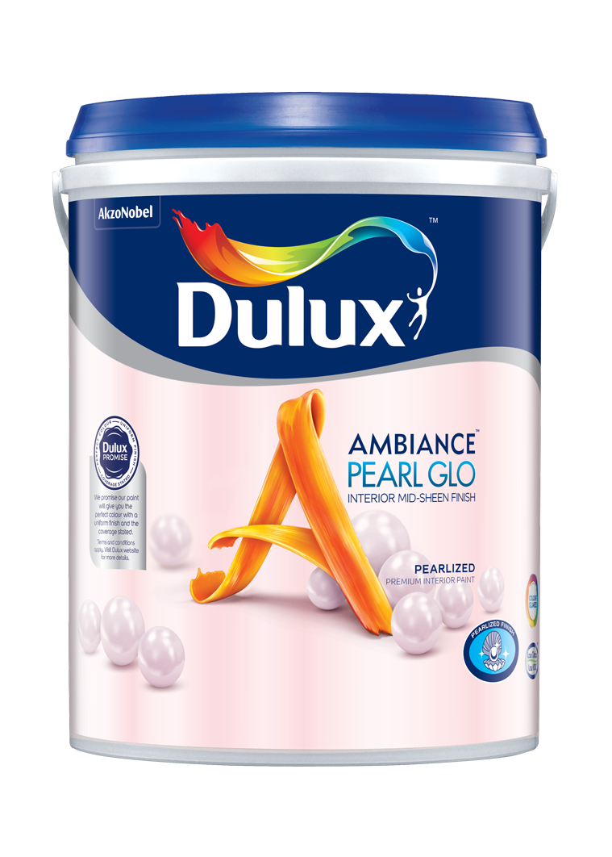
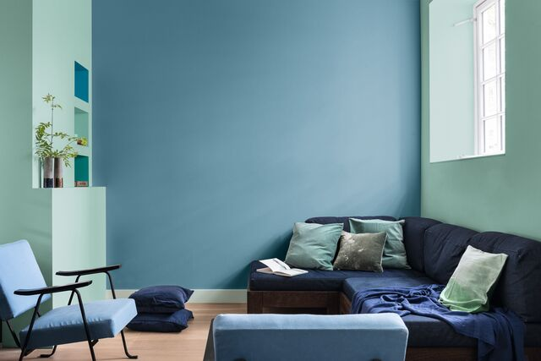
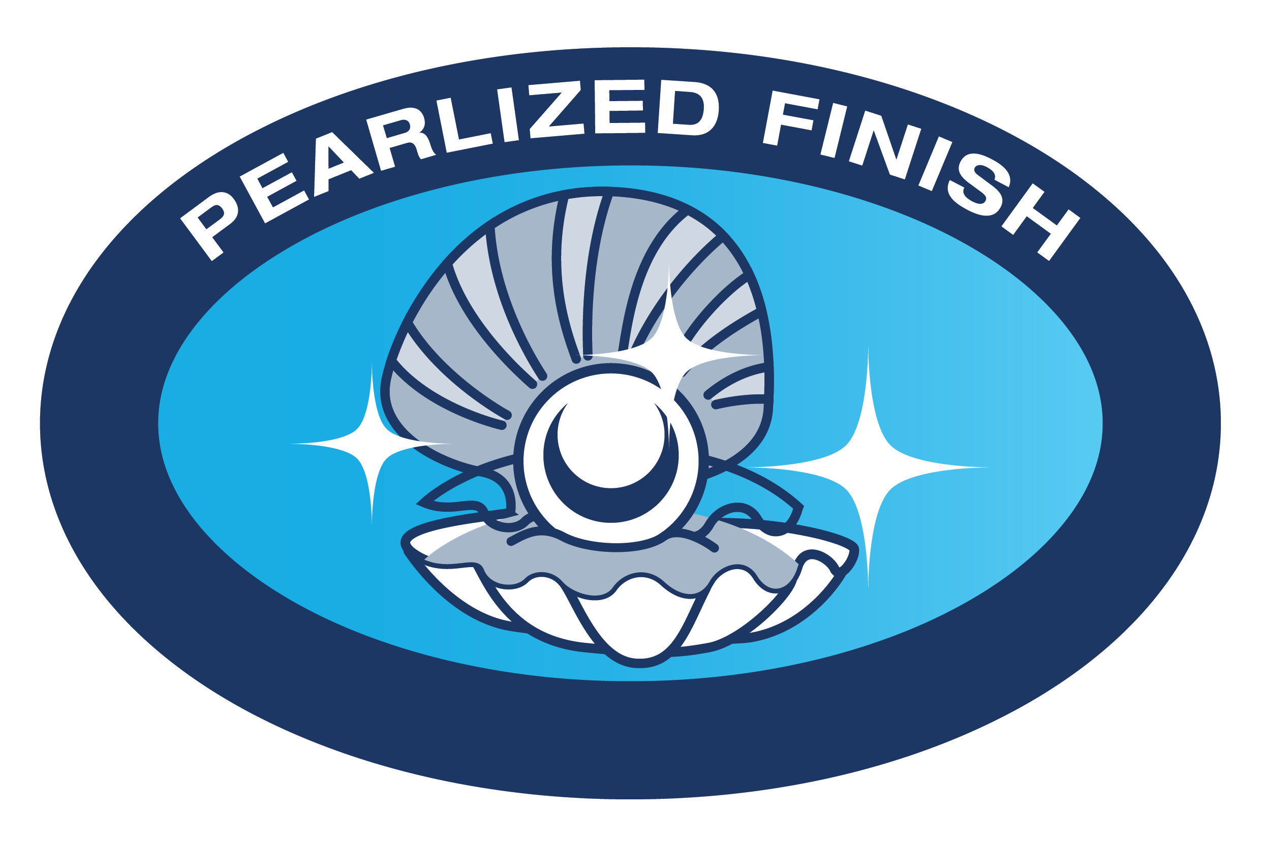
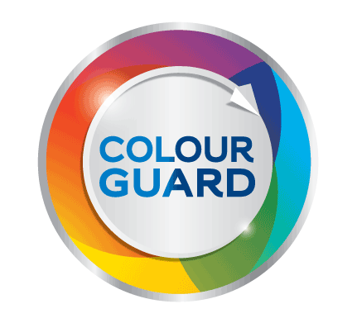
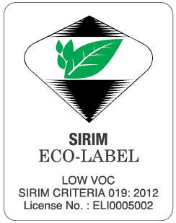
Dulux Ambiance Pearl Glo
Problem Statement
I want my home to give me a good feeling and sense of pride through the colors and style I choose. So I look to create my own contemporary style; inspired by the latest trend with beautiful colors and living spaces
Solution
Dulux Ambiance’ Pearl Glo with attractive pearlized mid-sheen finish that exudes the shimmers and luxury of pearls provides timeless & elegance interior ambiance, that reflect the latest design trends and help me personalised my living space
Benefits
Pearlized mid-sheen finish with long lasting colours that keep your homes looking beautiful for longer time.
Available in
1L, 5L, 18L
Product Features
Water/Solvent | Water-based
Finish | Mid-sheen
Coverage | 11-12 m²/L
Drying time | 2-3 hours
Colour Availability | > 2,500 colours

Slide 4
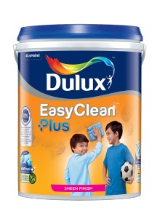
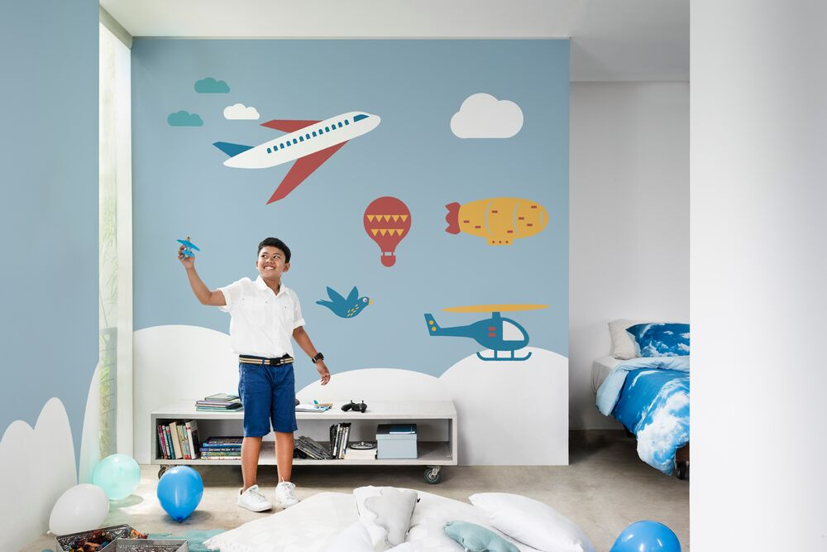
Dulux EasyClean Plus
Problem Statement
When painting a room, I want my walls to look good and stand the test of time however I know that daily life will eventually take its toll on them
Solution
Dulux EasyClean Plus with its unique Kidproof+ technology, delays common household stains from penetrating and can be easily wiped away, leaving walls looking fresh and clean
Benefits
Good looking walls with added germ (virus & bacteria) protection that keep your walls looking sparkling clean and fresh, for a longer time.
Available in
1L, 5L, 18L
Product Features
Water/solvent | Water-based
Finish | Sheen
Coverage | 11-12 m²/L
Drying time | 2-3 hours
Colour Availability | > 2,500 colours
Disclaimer: For more anti-virus detail information, refer to Dulux.com.my or product data sheet

Slide 5
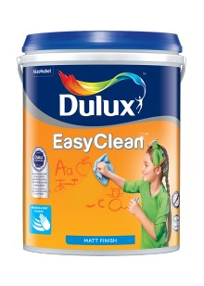
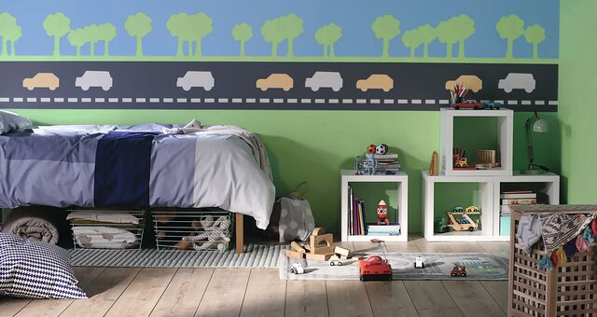


Dulux EasyClean
Problem Statement
I want my walls to look beautiful, but I know that they can be easily spoiled by common household stains.
Solution
Dulux EasyClean comes with easy cleaning functionality that combined with ColourGuard technology, provides walls with long lasting colours and able to withstand common household stains that can be wiped away easily.
Benefits
Clean walls with added anti-bacteria protection that keep your walls looking clean for a longer time.
Available in
1L, 5L, 18L
Product Features
Water/Solvent | Water-based
Finish | Matt
Coverage | 11-12 m²/L
Drying time | 2-3 hours
Colour Availability | > 2,500 colours

Slide 6
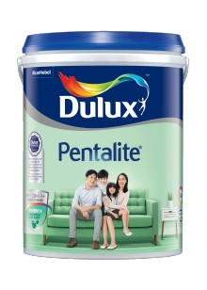
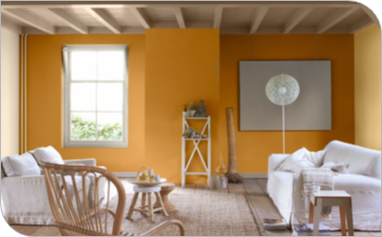
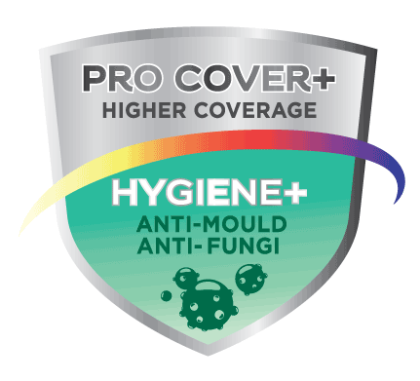
Dulux Pentalite
Problem Statement
My home is my pride and I want it to look the best always. Over time, mould and fungus appear that not only spoils the look of the house but also is harmful to health
Solution
Dulux Pentalite with its unique ProCover+ & Hygiene+ properties has anti-mould & fungus properties that keep your homes protected and looking good
Benefits
Healthier Homes that kept walls looking good and protected from fungus and mould.
Available in
1L, 5L, 18L
Product Features
Water/Solvent | Water-based
Finish | Smooth Matt
Coverage | 11-12 m²/L
Drying time | 2-3 hours
Colour Availability | >2,500 colours

Slide 7
INTERIOR MASS & ECONOMY WALL PAINT

Slide 8
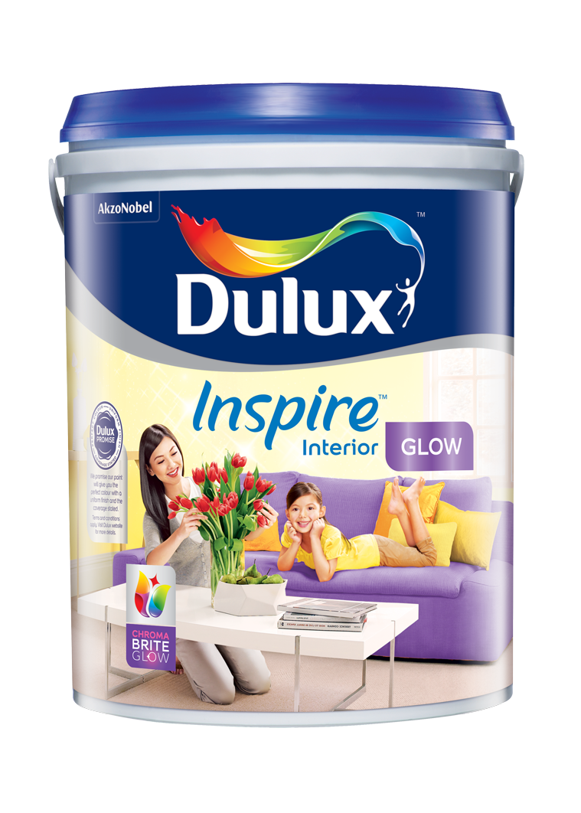
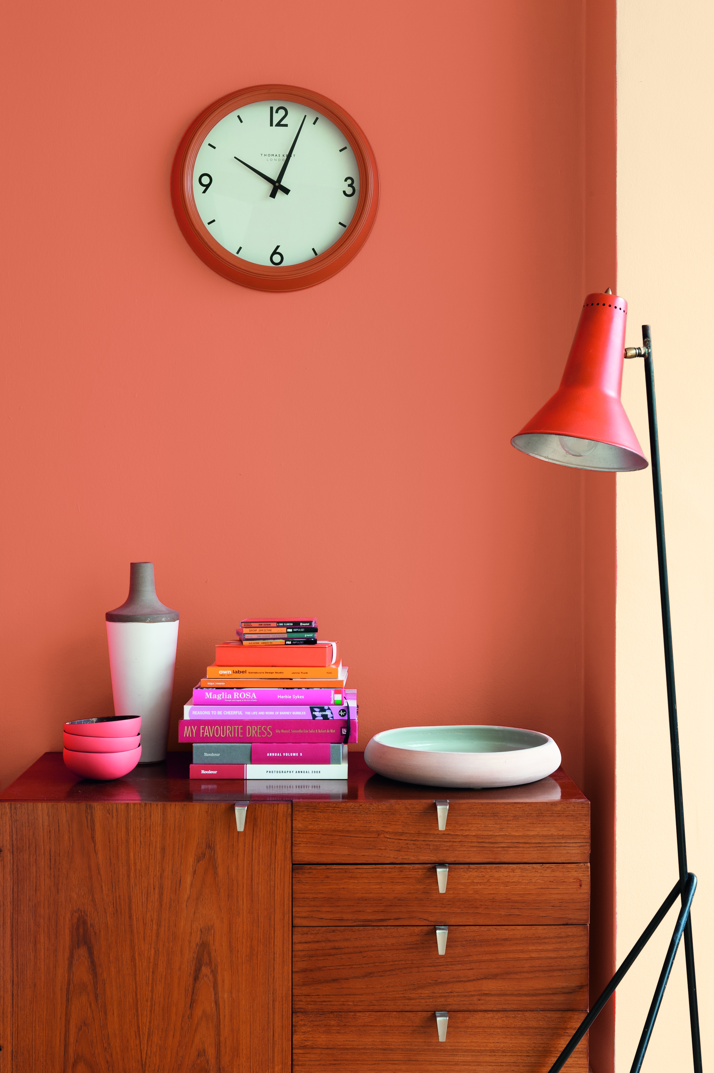
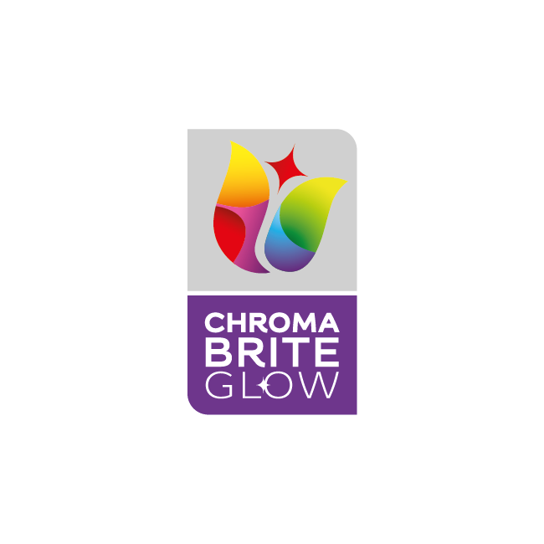

Dulux Inspire Interior – Glow
Problem Statement
With activity around the house, the wall can easily get dirty and look dull. But usually Washable paint is more expensive than I can afford.
Solution
Dulux Inspire Interior Glow, interior wall with a high sheen finished that not only has ChromaBrite technology that can keep your wall brighter for longer.
Benefits
Keep the wall looks beautiful, clean and safe . So, it becomes a fond destination for all the people I care about.
Available in
1L, 5L, 18L
Product Features
Finish | High Sheen
Coverage | 10-11 m²/L
Opacity | Good Opacity
Colour Availability | 1 Ready Mix >2,500 colours

Slide 9
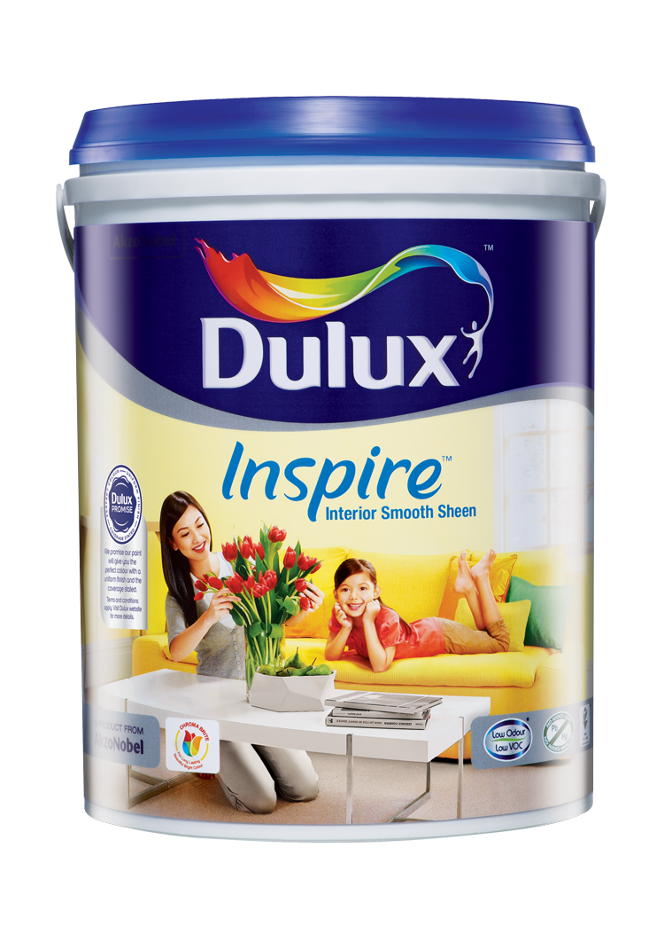
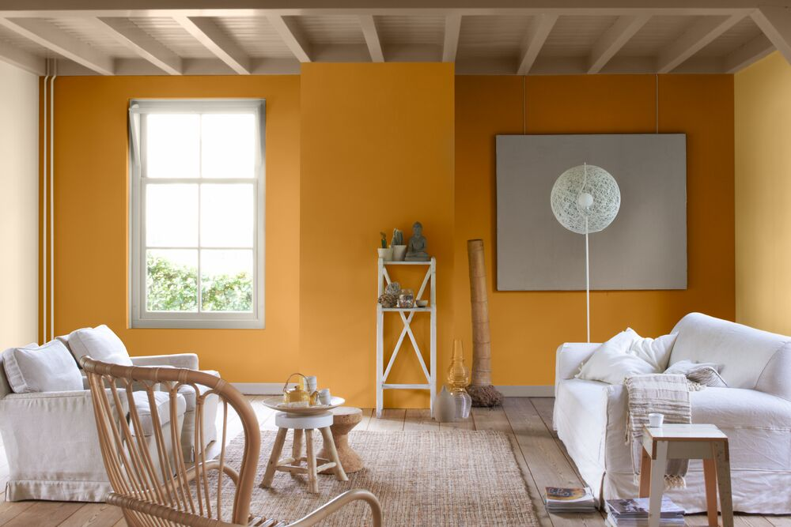

Dulux Inspire Interior – Smooth Sheen
Problem Statement
With activity around the house, the wall can easily get dirty and look dull. But usually Washable paint is more expensive than I can afford.
Solution
Dulux Inspire Interior Smooth Sheen, interior wall with a mid sheen finished that not only has ChromaBrite technology that can keep your wall brighter for longer.
Benefits
Keep the wall looks beautiful, clean and safe . So, it becomes a fond destination for all the people I care about.
Available in
1L, 5L, 18L
Product Features
Finish | Mid Sheen
Coverage | 10-11 m²/L
Opacity | Good Opacity
Colour Availability | 1 Ready Mix, >2,200 colours

Slide 10
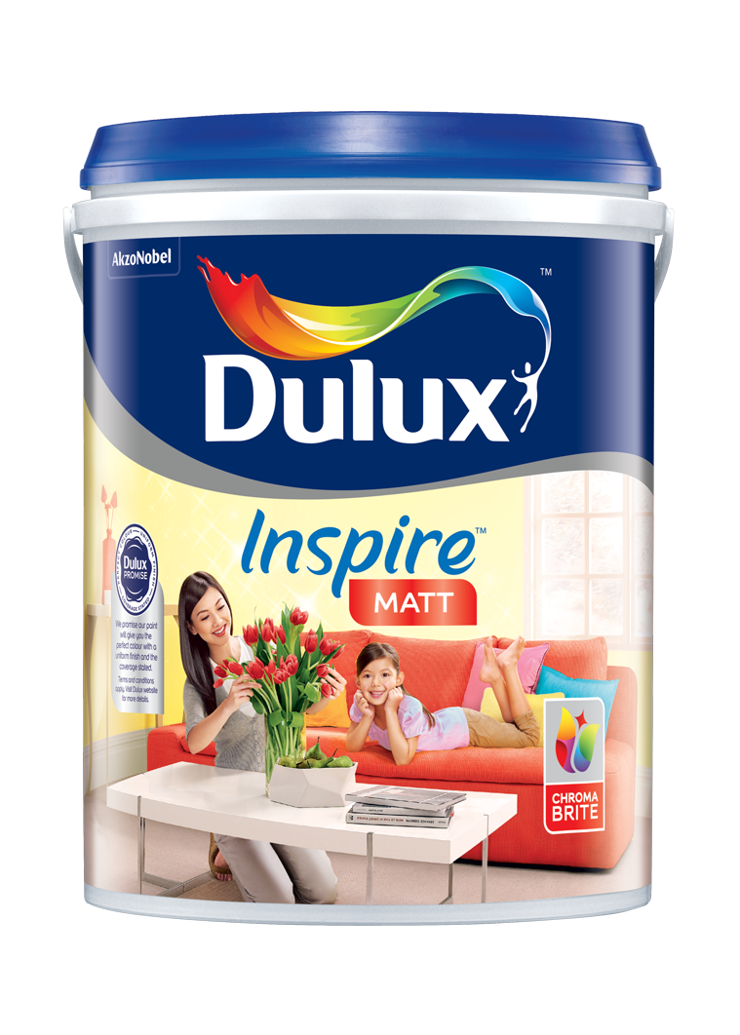
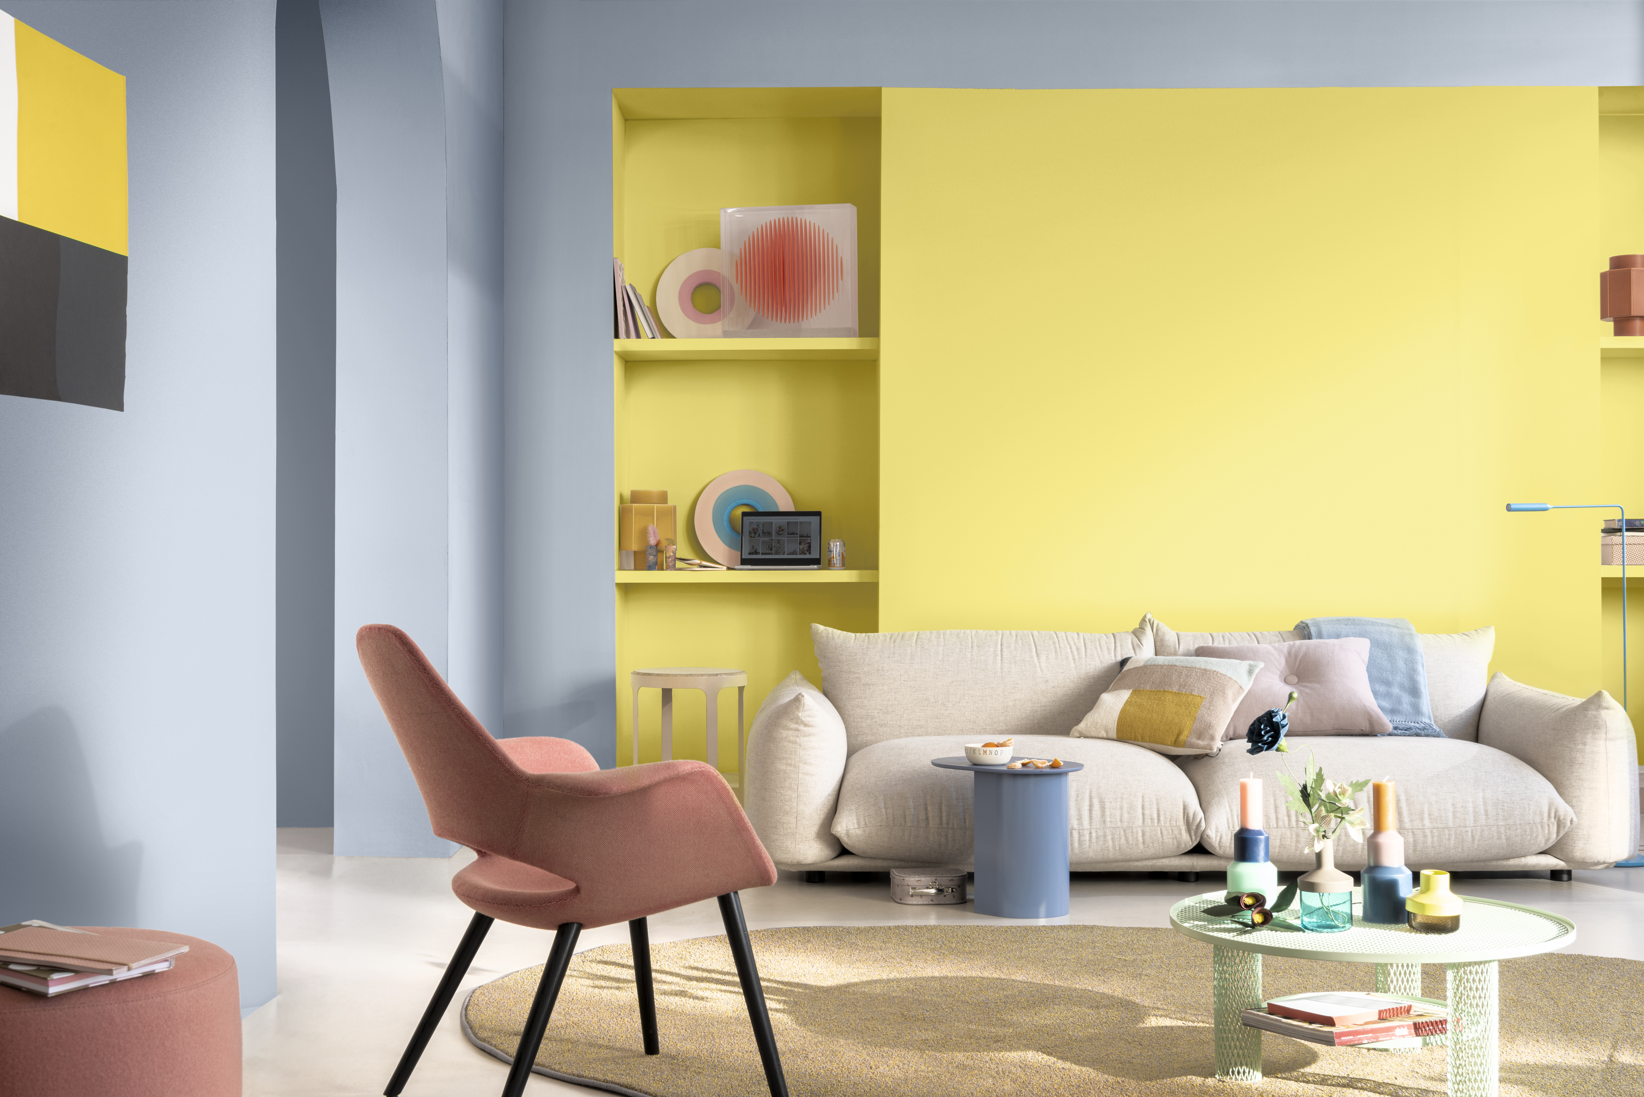
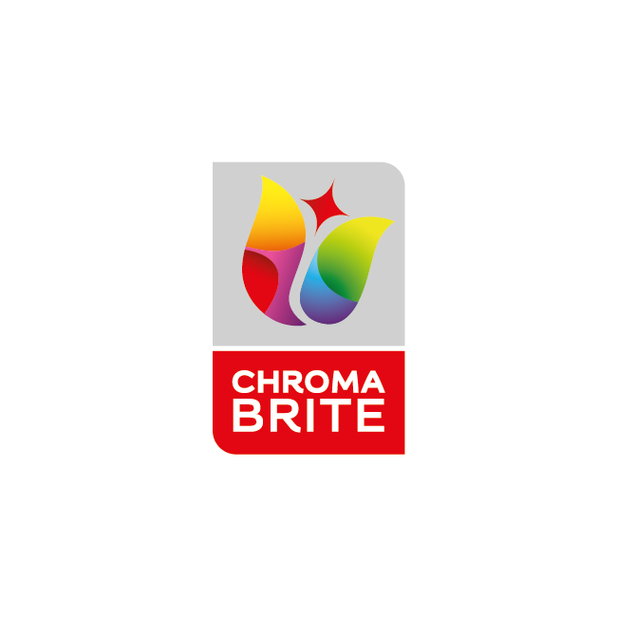
Dulux Inspire Interior – Matt
Problem Statement
With activity around the house, the wall can easily get dirty and look dull. But usually Washable paint is more expensive than I can afford.
Solution
Dulux Inspire Interior Matt, interior wall with a matt finished that not only has ChromaBrite technology that can keep your wall brighter for longer.
Benefits
Keep the wall looks beautiful, clean and safe . So, it becomes a fond destination for all the people I care about.
Available in
1L, 5L, 18L
Product Features
Finish | Matt
Coverage | 10-11 m²/L
Opacity | Good Opacity
Colour Availability | 1 Ready Mix, >2,500 colours

Slide 11
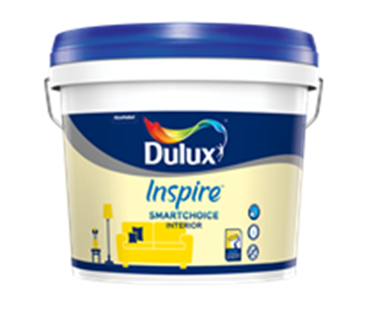
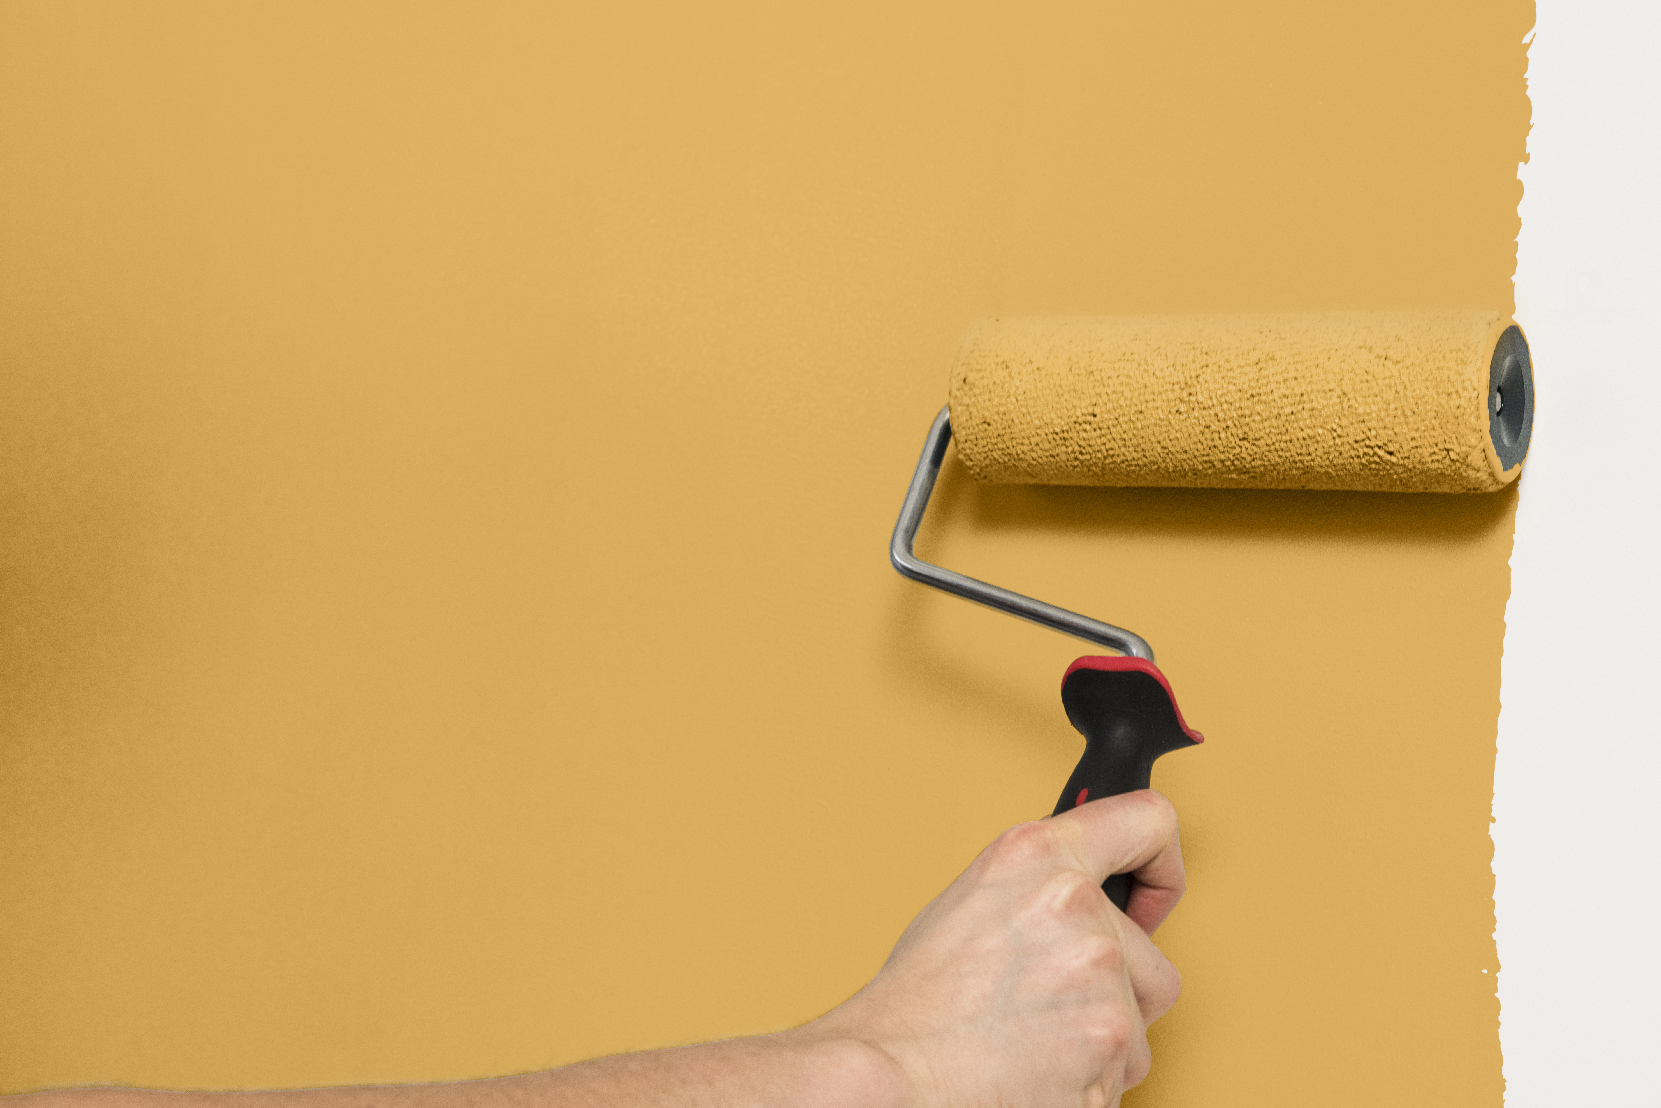

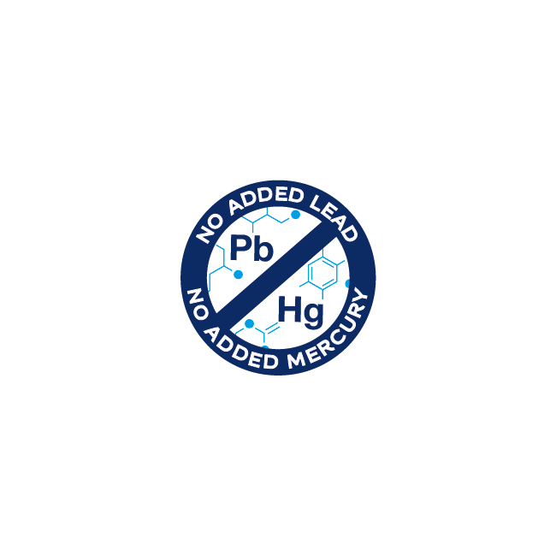

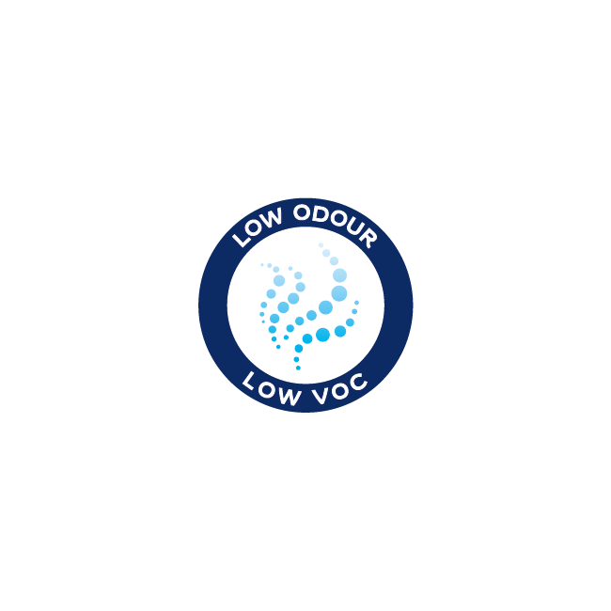
Dulux Inspire SmartChoice Interior
Problem Statement
The need for affordable Interior paint from trustworthy paint brand that can give basic good paint performance.
Solution
Dulux Inspire SmartChoice Interior is affordable Interior paint that gives you good coverage & opacity better than other regular paint in the market.
Benefits
Smart Choice for your wall. For Affordable Good Quality Paint.
Available in
7L, 18L
Product Features
Finish | Matt
Coverage | 10 – 12 m²/L
Opacity | Good Opacity
Colour Availability | 1 Ready Mix, >200 colours

Slide 12
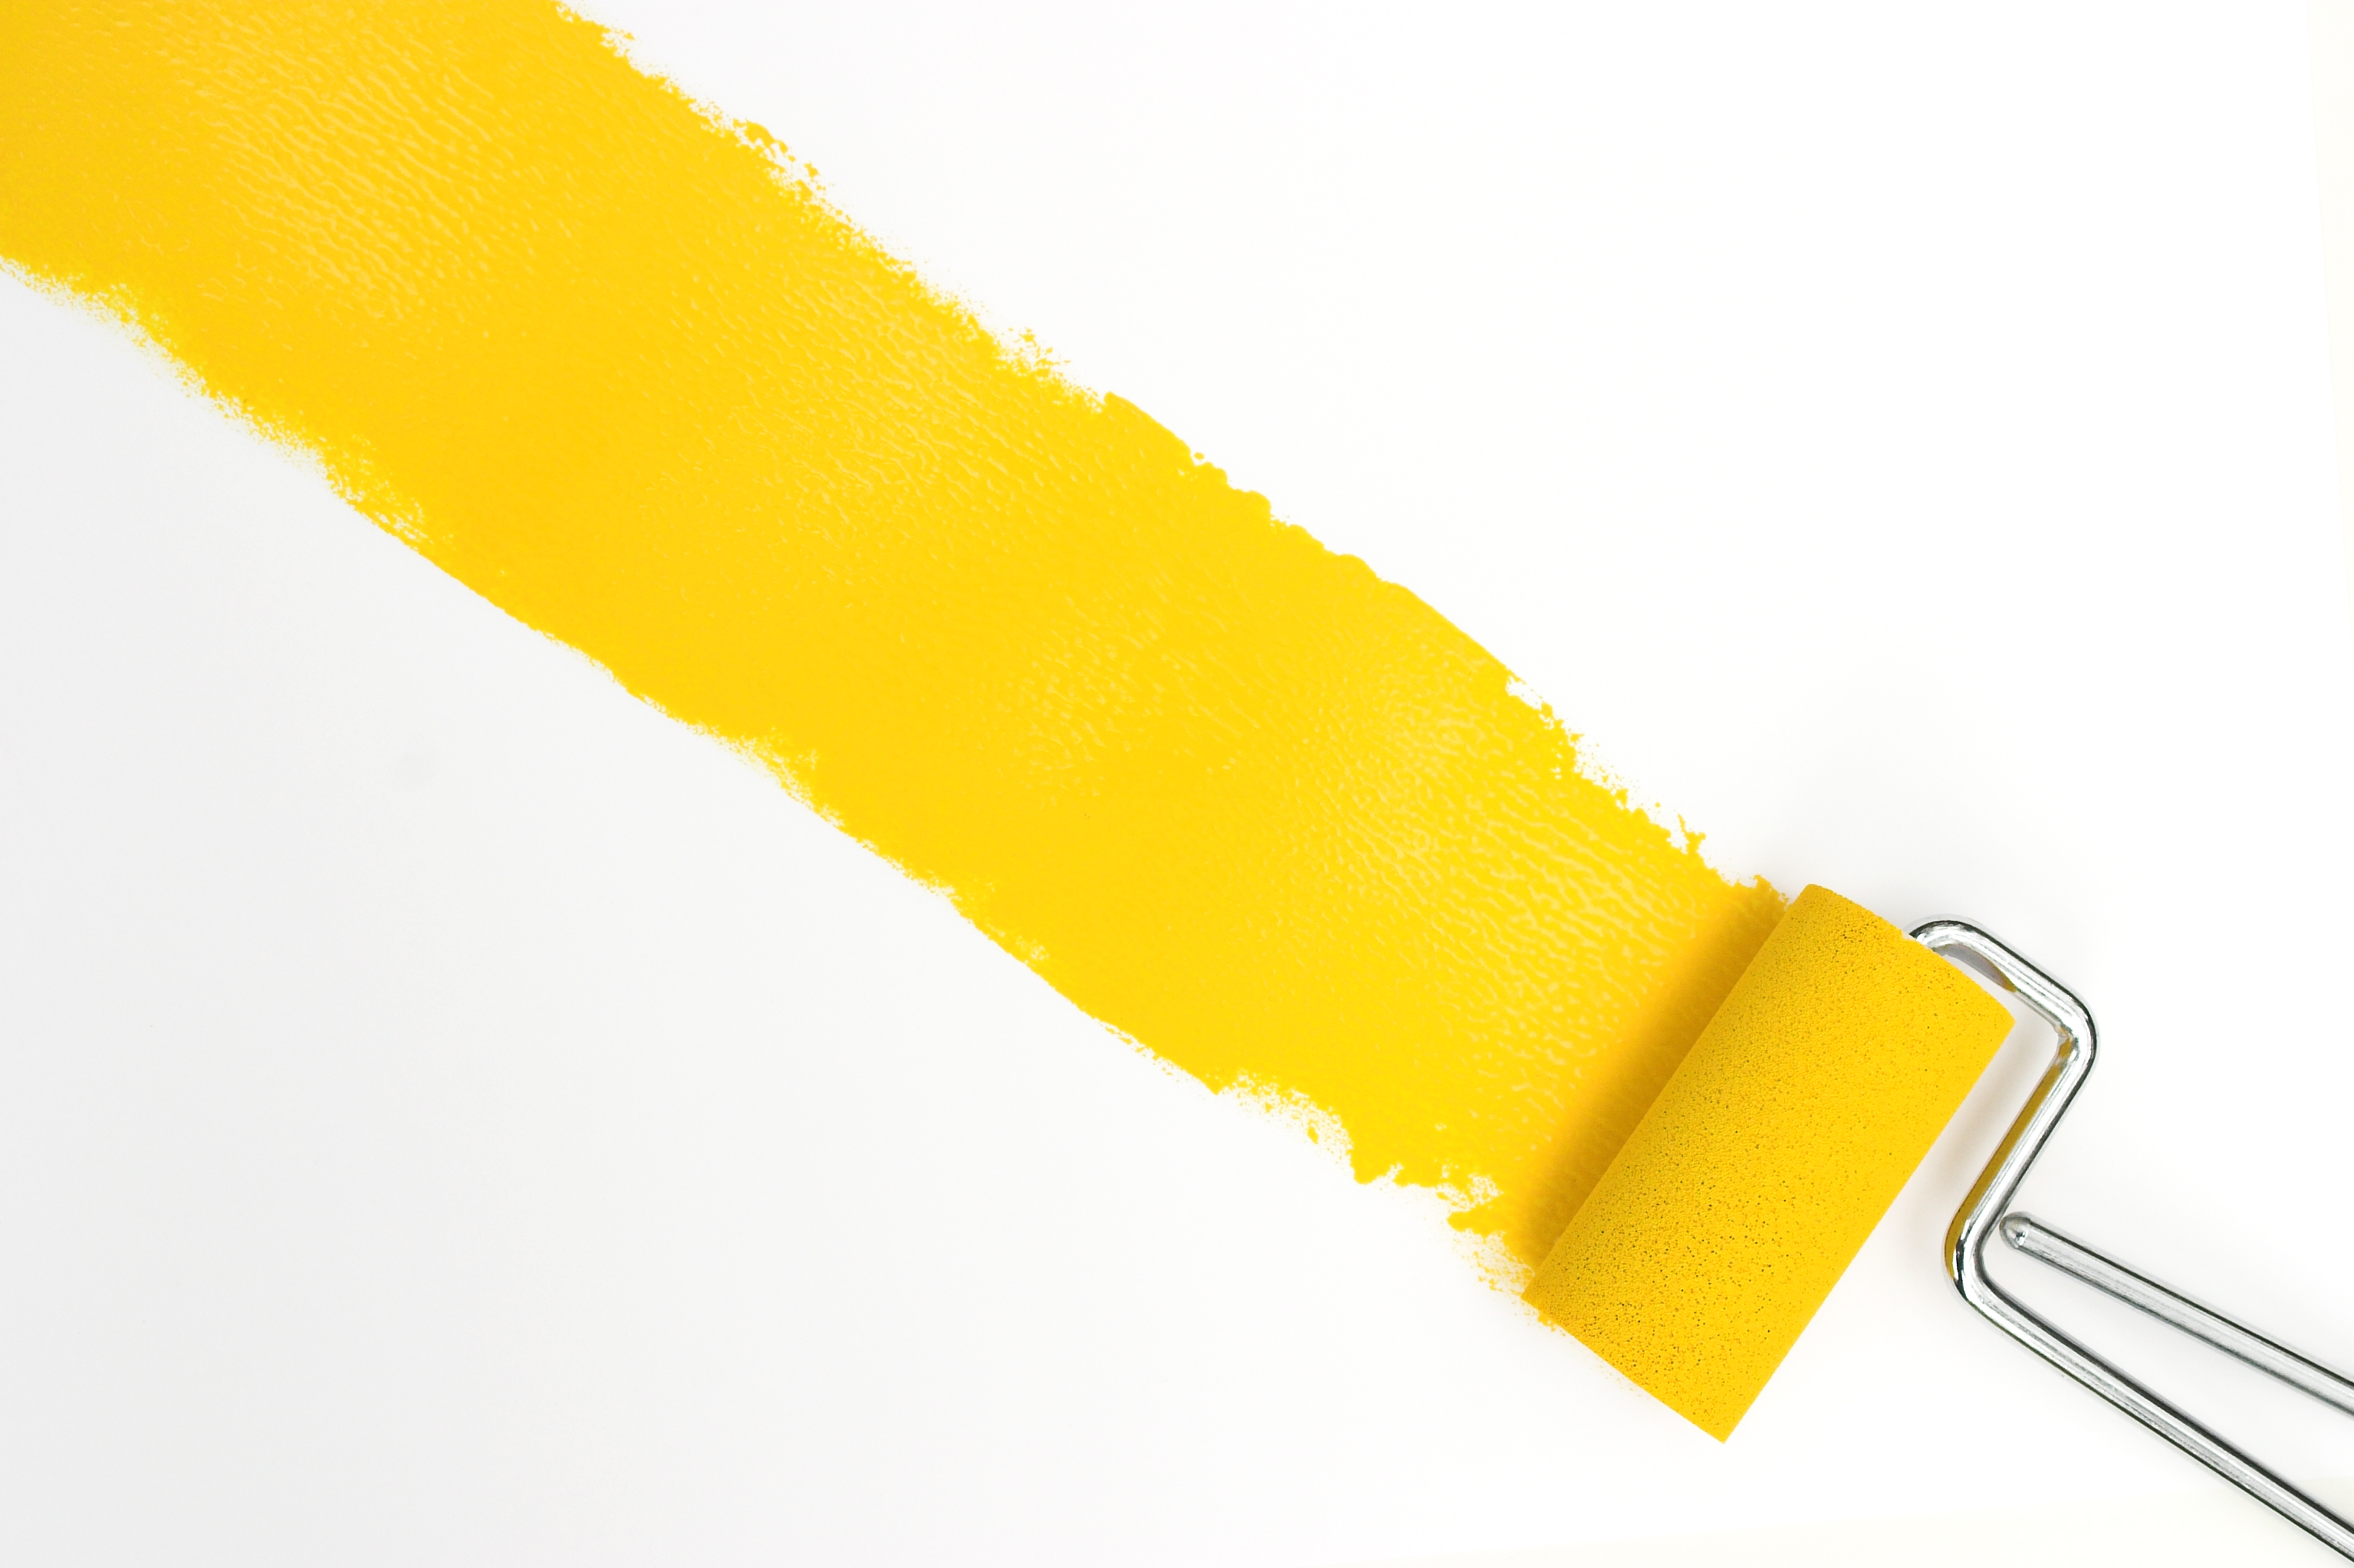
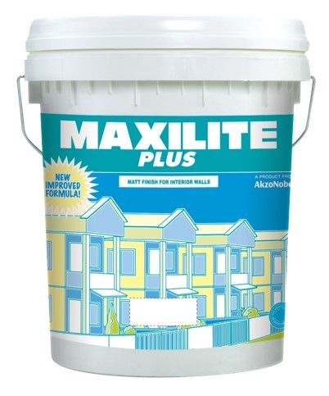

MAXILITE PLUS
Problem Statement
My wall looks shabby. It is very dirty, peeling off here and there. Every time I lay back on the wall I can see white marks on my shirt. I was supposed to repaint it months ago, but my money is limited and home decoration is not on my priority list. I don’t think I can wait any longer, it’s time to paint.
Solution
Maxilite Plus is affordable paint that simply covers the wall and ceiling.
Benefits
Maxilite Plus, simple and convenient paint that you need
Available in
7L, 18L
Product Features
Finish | Matt
Coverage | 9 – 10 m²/L
Opacity | Basic Opacity
Colour Availability | 42 Ready Mix

Slide 13
EXTERIOR PREMIUM WALL & ROOF PAINT

Slide 14
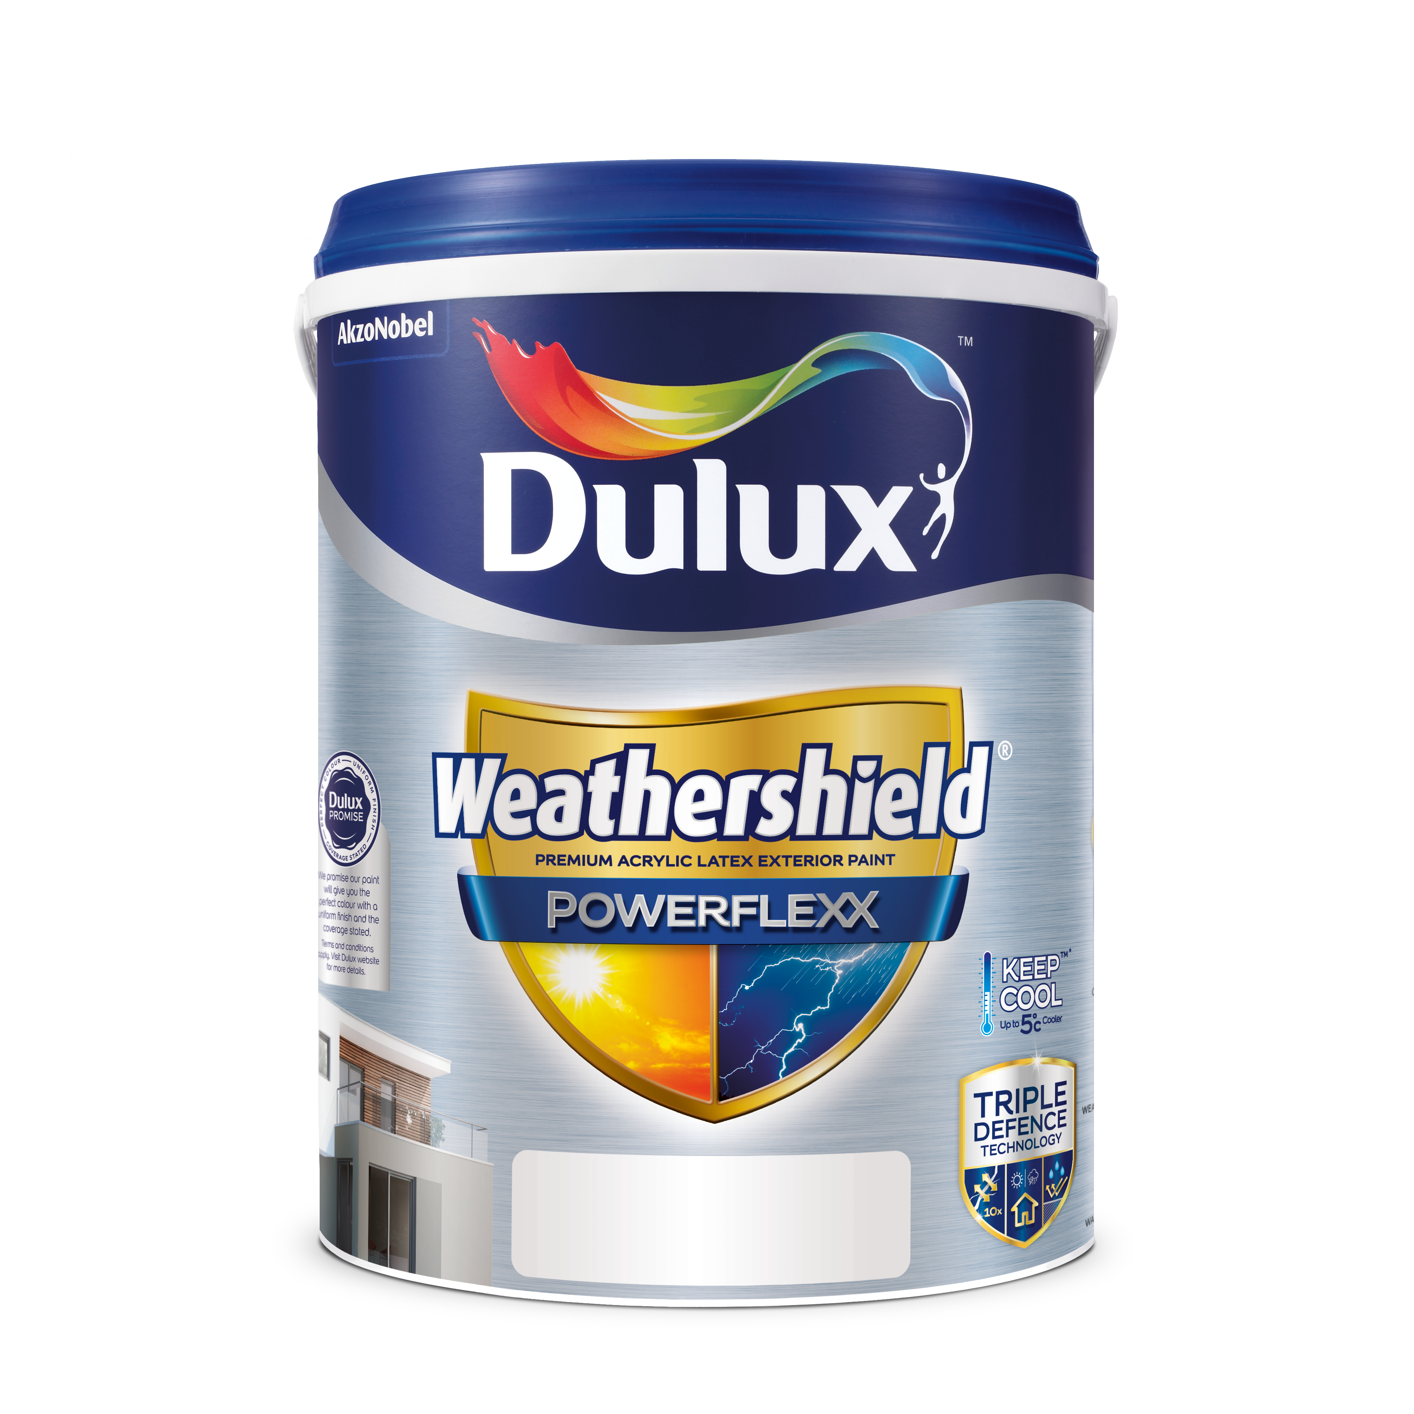
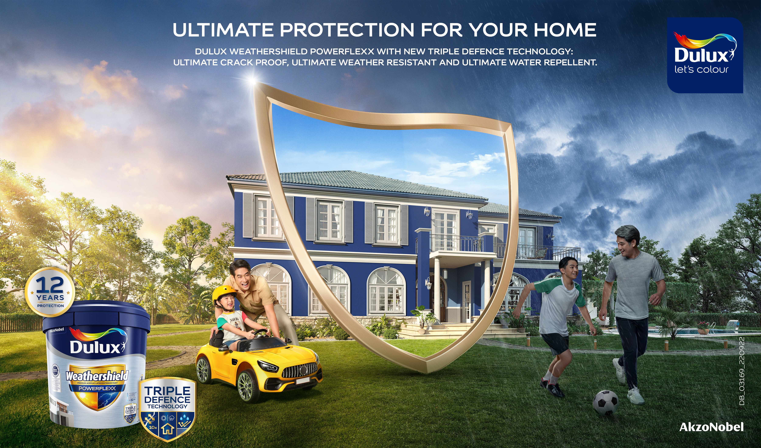

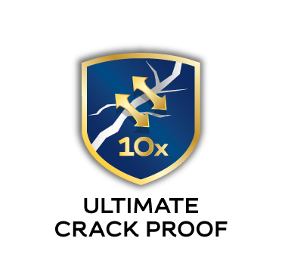

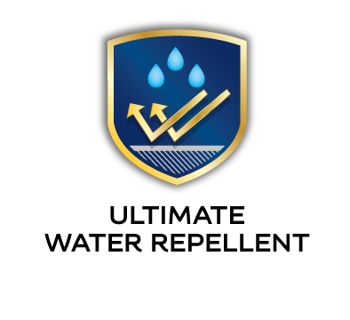
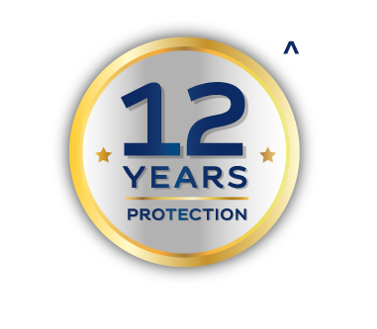

Dulux Weathershield Powerflexx
Problem Statement
My house is a symbol of my success, a pristine looking house fills me with pride. But constant rain and sun causing cracks on the walls, when water seeps through these cracks, it causes further damage to the structure. I want to give my house the best possible protection.
Solution
Dulux Weathershield Powerflexx with its Triple Defence Technology, provides ultimate crack proof, water repellent and ultimate weather resistant for your home. DWS Powerflexx is an elastomeric paint comes with thick and tough yet highly stretchable paint film, it covers 10x* wider crack than normal paints, water repellent and weather resistant.
Benefits
A long lasting beautiful home free from cracks, algae & fungus, dirt & water marks, colour fading, alkali and with 12 years of protection!
Available in
1L, 5L, 18L
Product Features
Water/Solvent | Water-based
Finish | Sheen
Coverage | Up to 12 m²/L
Drying time | 2-3 hours
Colour Availability | >2,500 colours
Warranty | 12 years. Refer to T&C at duluxweatherhsieldwarranty.com.my
Disclaimer: Under controlled lab test conditions.

Slide 15
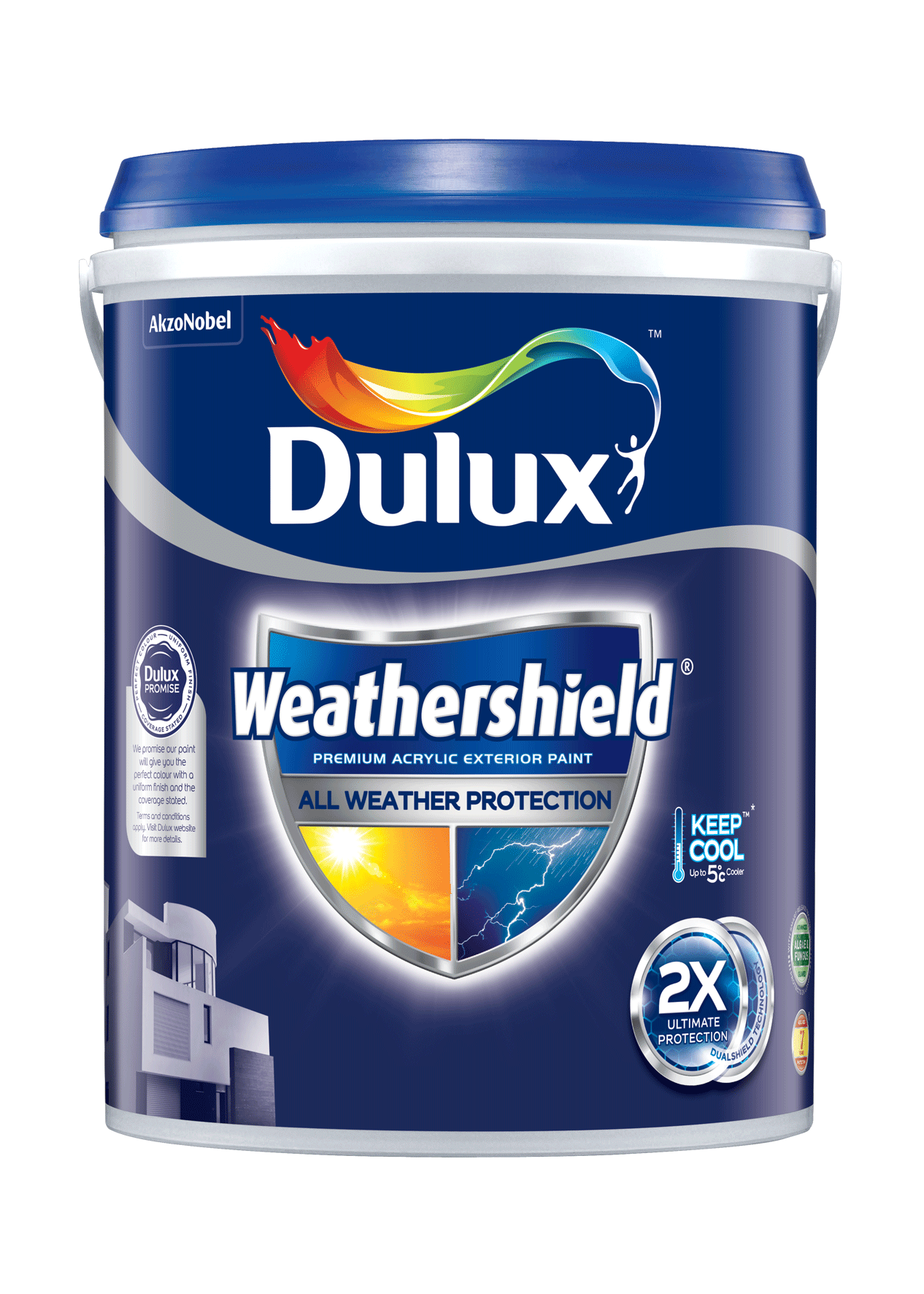
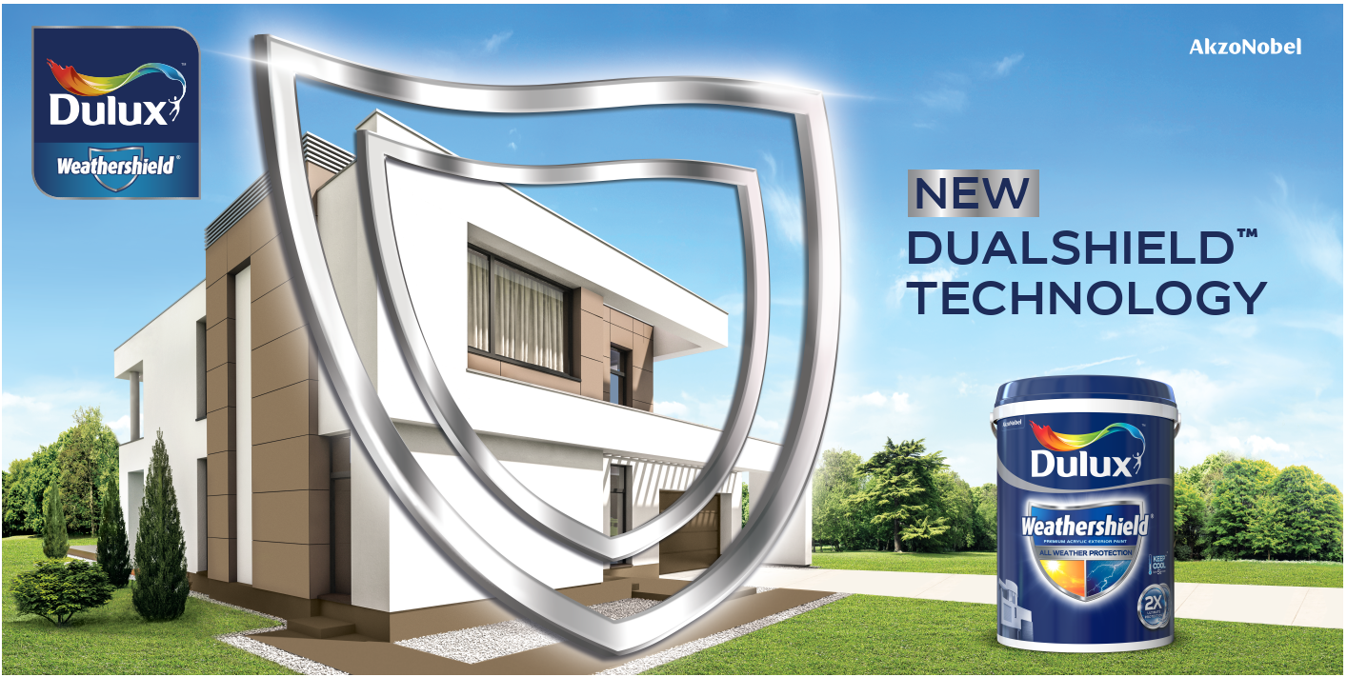
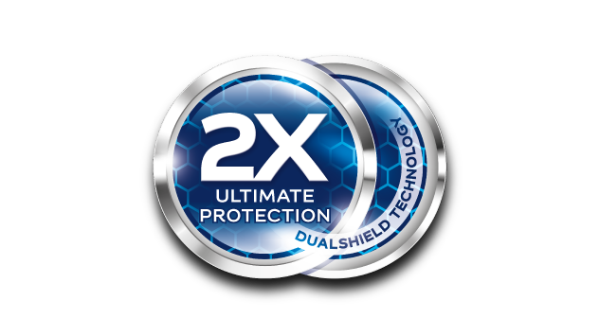
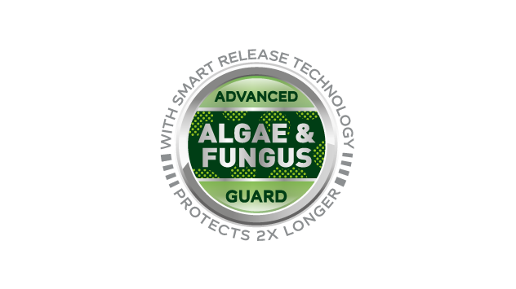

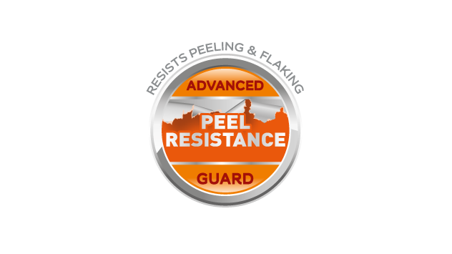
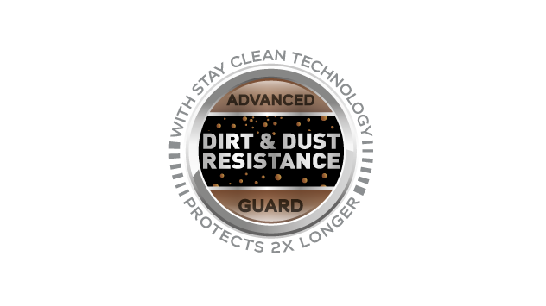
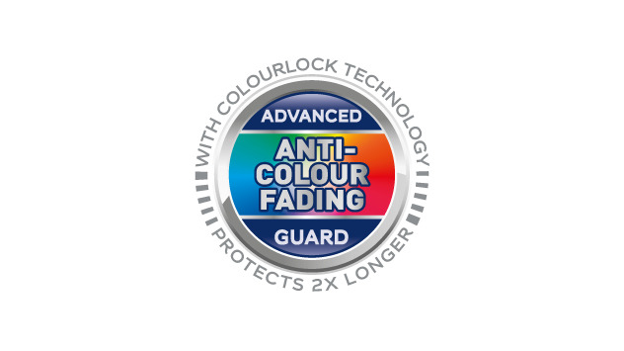
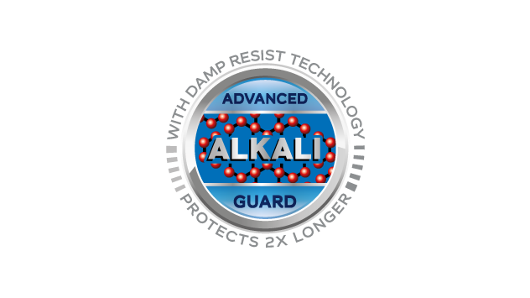
Dulux Weathershield
Problem Statement
My home is a symbol of my success, a pristine-looking house fills me with pride. Harsh weather and air pollution make the exterior walls of my home look old and dirty sooner than expected. I wish for an exterior paint that would keep my house looking clean and fresh for longer.
Solution
Dulux Weathershield, with its Dualshield™ Technology, provides 2x* longer protection against colour fading, alkali, dirt and dust deposits and algae & fungus. (* Compared to standard exterior paint)
Benefits
Cleaner, brighter and fresher home with 2X Ultimate Protection against all weather with Dulux Weathershield, comes with 7 years of protection assurance.
Available in
1L, 5L, 18L
Product Features
Water/Solvent | Water-based
Finish | Low Sheen
Coverage | Up to 12 m²/L
Drying time | 2-3 hours
Colour Availability | >2,500 colours
Warranty | 7 years. Refer to T&C at duluxweatherhsieldwarranty.com.my

Slide 16
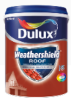
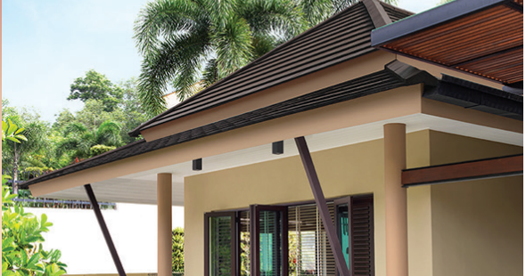
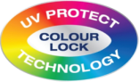

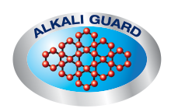
Dulux Weathershield Roof
Problem Statement
My home is a symbol of my success, a pristine-looking house fills me with pride. Harsh weather make the roof tiles of my house look old and dirty sooner than expected. I wish for an exterior roof paint that keep my roof tiles looking clean and fresh for longer, while cooling at home.
Solution
Dulux Weathershield Roof, with its Colour Lock Technology, Algae/ Fungus Guard and Alkali Guard provides longer protection against colour fading, dirt and alkali to the roof tiles and its Keep Cool Technology helps to shield roof against sun’s heat.
Benefits
Cleaner, fresher, long-lasting roof colour and cooler home with Dulux Weathershield Roof!
Available in
5L, 18L*
Product Features
Water/Solvent | Water-based
Finish | Mid Sheen
Coverage | Up to 20 m²/5L
Drying time | 2-3 hours
Colour Availability | 10 ready-mix colours; only 3 selected popular colours in 18L

Slide 17
EXTERIOR MASS WALL PAINT

Slide 18


Dulux Inspire Exterior
Problem Statement
The weather conditions and the sun exposure make my wall colour fading faster than Interior, I need more production for exterior than my Interior wall .
Solution
Dulux Inspire Exterior formulate especially for your exterior matt paint wall. ChromaBrite™ technology keeps your wall brighter for longer. With Water Resistance, Dirt Resistance, Peeling Resistance and Algae & Fungus Resistance properties give extra protection for exterior wall from sun & rain exposure.
Benefits
Keep the exterior wall looking beautiful for longer. So, it is always ready to welcome people that I care to come to our house.
Available in
1L, 5L, 18L
Product Features
Finish | Matt
Coverage | 10-12 M²/ Litre
Opacity | Good Opacity
Colour Availability | 1 Ready Mix, >2500 colours

Slide 19
TRIMS PREMIUM PAINT

Slide 20




Trims/Enamels - Dulux Aura High Gloss
Problem Statement
I like very glossy look and feel on my wood & metal furniture. But with passage of time the glossiness fades away and my furniture loses its beauty. How can I restore my furniture? How can I protect the furniture such that it retains its beauty over the years?
Solution
Dulux Aura High Gloss is a premium high gloss enamel, suitable for use on interior and exterior metal and wood surfaces, that gives a smooth mirror like finish. With unique Diamond Strong technology, it provides excellent color & gloss retention to uplift the look of wood & metal items and helps to nicely blend them in with the surroundings.
Benefits
Keep my wood & metal furniture look glossy & brand new and provide protection
Available in
1L & 5L
Other benefits:
High gloss and excellent gloss retention
Good protection against UV
Product Features
Finish | High Gloss
Coverage | Up to 16-18 m2 /L
Opacity | 2 coats
Colour Availability | Ready Mix – 43 colours Tinting (Base A/B/C/D) – Up to 2,000 colours
Paint Type | Solvent Based
Colour Fastness | Excellent colour fastness
Mould & Fungus Protection | Excellent durability & fungus resistance
Durability | NA

Slide 21



Trims/Enamels - Dulux Aura Gloss
Problem Statement
I like glossy look and feel on my wood & metal furniture. But with passage of time the finish fades away and my furniture loses its beauty. How can I paint/repaint my furniture with fast drying paint with low smell? How can I protect the furniture such that it retains its beauty over the years?
Solution
Dulux Aura Gloss is a high quality non-yellowing gloss finish, suitable for use on interior and exterior metal and wood surfaces. With unique Diamond Strong technology, it provides excellent color & gloss retention to uplift the look of wood & metal items and helps to nicely blend them in with the surroundings.
Benefits
Keep my wood & metal furniture look glossy & brand new and provide protection
Available in
1L & 5L
Other benefits:
Quick drying & Non-yellowing
Colour retention
Low Odour, Low VOC
Product Features
Finish | Gloss
Coverage | Up to 10-12 m2 /L
Opacity | 2 coats
Colour Availability | Ready Mix – Black & White Tinting (Base A/B/C/D) – Up to 2,000 colours
Paint Type | Water Based
Colour Fastness | NA
Mould & Fungus Protection | NA
Durability | NA

Slide 22


Trims/Enamels - Dulux Aura Satin Matt
Problem Statement
I prefer a balanced (i.e. neither too glossy nor too matt) look and feel on my wood & metal furniture. But with passage of time the finish fades away and my furniture loses its beauty. How can I paint/repaint my furniture with fast drying paint with low smell? How can I protect the furniture such that it retains its beauty over the years?
Solution
Dulux Aura Satin Matt is a high quality non-yellowing satin matt finish, suitable for use on interior and exterior metal and wood surfaces. With unique Diamond Strong technology, it provides excellent color & gloss retention to uplift the look of wood & metal items and helps to nicely blend them in with the surroundings.
Benefits
Keep my wood & metal furniture look glossy & brand new and provide protection
Available in
1L & 5L
Other benefits:
Quick drying & Non-yellowing
Colour retention
Low Odour, Low VOC
Product Features
Finish | Satin Matt
Coverage | Up to 10-12 m2 /L
Opacity | 2 coats
Colour Availability | Ready Mix – Black & White Tinting (Base A/B/C/D) – Up to 2,000 colours
Paint Type | Water Based
Colour Fastness | NA
Mould & Fungus Protection | NA
Durability | NA

Slide 23


Trims/Enamels Undercoat – Dulux Aura Speed Undercoat
Problem Statement
It is critical to ensure painting system is followed through especially for wood, metal & galvanized steel. This will correctly prepared and primed interior and exterior wood and metal surfaces where high film build, and smoothness are required.
Solution
Dulux Aura Speed Undercoat is an acrylic copolymer-based undercoat. Its revolutionized formulation enables it to be used as an undercoat as well as stain sealer.
Benefits
Exhibits stain sealing property which prevents joss stick and cigarette stains from permeating through the new paint film and causing yellow discolouration. Its alkali resistant property enables it to be applied on cementious substrate.
Available in
1L & 5L
Other benefits:
Exhibits stain sealing properties
Alkali resistant
Quick Drying
Product Features
Finish | Satin Matt
Coverage | Up to 13 m2 /L
Opacity | 1 coat
Colour Availability | Ready Mix - White
Paint Type | Solvent Based
Colour Fastness | NA
Mould & Fungus Protection | NA
Durability | NA

Slide 24


Trims/Enamels Primer
Dulux Aura Metal Grey Green Zinc Phosphate
Problem Statement
It is critical to ensure painting system is followed through especially for metal surfaces which having corrosion problem.
Solution
Dulux Aura Metal Grey Green Zinc Phosphate is a solvent based, anti-corrosion, protective primer
Benefits
Suitable for use on interior and exterior ferrous and non-ferrous metalwork including steelwork, new, weathered and pre-treated zinc and galvanised iron. It may also be applied over pre-treated aluminium. Pre-treatment with an appropriate pre-treatment primer is required to ensure good adhesion.
Available in
1L & 5L
Other benefits:
Provides good corrosion protection
Excellent opacity
Single coat coverage
Product Features
Finish
Coverage | Up to 11 m2 /L
Opacity | 1 coat
Colour Availability | Ready Mix - Grey Green
Paint Type | Solvent Based
Colour Fastness | NA
Mould & Fungus Protection | NA
Durability | NA

Slide 25


Trims/Enamels Primer - Dulux Aura Wood & Metal Primer
Problem Statement
It is critical to ensure painting system is followed through especially for wood & metal surfaces as primer
Solution
Dulux Aura Wood & Metal Primer is is a high-quality water-based primer
Benefits
Suitable for use on a wide variety of substrate including metal and wood. This specially formulated primer provides good adhesion on wood and metal without the strong odour of solvent based primer.
Available in
1L & 5L
Other benefits:
Rust Prevention
Good adhesion properties
Product Features
Finish
Coverage | Up to 9 - 10 m2 /L
Opacity | 1 coat
Colour Availability | Ready Mix - White
Paint Type | Water Based
Colour Fastness | NA
Mould & Fungus Protection | NA
Durability | NA

Slide 26
TRIMS MASS PAINT

Slide 27






Trims/Enamels - Dulux Inspire Gloss
Problem Statement
I like very glossy look and feel on my wood & metal furniture. But with passage of time the glossiness fades away and my furniture loses its beauty. How can I restore my furniture? How can I protect the furniture such that it retains its beauty over the years?
Solution
Dulux Inspire Gloss comes with advance Chroma Brite Technology that enables all interior and exterior wood & metal surfaces staying bright in colour with a smooth finish. It has a durable formulation that gives good gloss retention.
Benefits
Keep my wood & metal furniture look glossy & brand new and provide protection with affordable range.
Available in
1L & 5L
Other benefits:
Stay bright colour
Good Gloss Retention
Smooth Finish
Product Features
Finish | Gloss
Coverage | Up to 16 m2 /L
Opacity | 2 coats
Colour Availability | Ready Mix – 28 colours
Paint Type | Solvent Based
Colour Fastness | NA
Mould & Fungus Protection | NA
Durability | NA

Slide 28
WOODCARE PREMIUM PAINT

Slide 29



Woodcare - Dulux Woodcare Satinwood
Problem Statement
I want to renew the look and feel of my interior wood & metal furniture since with ongoing usage, their finish tends to get worn out. How can I protect my wood such that my wooden items keep looking new for long? I want to change the color of my wooden furniture to give it a new look
Solution
Dulux Woodcare Satinwood imparts all types of wood & also metal surfaces a soft and smooth satin (i.e. egg-shell like) finish. It is quick drying and provides good resistance to scratches and stains. It provides long lasting protection with beautiful opaque colors.
Benefits
Renew my interior wood & metal furniture look nice again.
Available in
1L & 5L
Other benefits:
Great opacity & coverage
Resistance to scratches & stains
Luxurious smooth satin finish
Product Features
Finish | Satin
Coverage | Up to 12 m2 /L
Opacity | 2 coats
Colour Availability | Ready Mix – 4 colours Tinting (Base A/B/C/D) – Up to 2,000 colours
Paint Type | Solvent Based
Colour Fastness | NA
Mould & Fungus Protection | NA
Durability | NA

Slide 30



Woodcare - Dulux Woodcare Timbertone
Problem Statement
I love my wood and want to enhance the beauty my interior wood furniture & flooring. But with ongoing usage, their finish tends to get worn out. I’m fond of the natural look of my indoor wooden furniture & want to glorify its wood grains. How can I refresh my interior wooden furniture & parquet flooring to look brand new?
Solution
Dulux Woodcare Timbertone is a durable polyurethane-reinforced varnish for the protection and decoration of all wood surfaces including parquet floors, paneling, wooden doors and furniture. It is available in clear glossy & satin and a also selection of glossy natural colors and offers good resistance to scratches and stains. The finish is designed to bring out the beauty of wood by highlighting the wood grains and good film clarity.
Benefits
My interior wood furniture & flooring have been protected and able to keep the natural look and feel
Available in
1L & 5L
Other benefits:
Resistance to scratches & stains
Great gloss retention
Great film clarity
Product Features
Finish | Clear Gloss / Satin
Coverage | Up to 15 m2 /L
Opacity | 3 coats
Colour Availability | Ready Mix – 12 colours
Paint Type | Solvent Based
Colour Fastness | NA
Mould & Fungus Protection | NA
Durability | NA

Slide 31



Woodcare - Dulux Woodcare Timbercolour
Problem Statement
I want to renew the look and feel of my exterior wooden items since with ongoing usage & weathering, their finish tends to get worn out. How can I protect my outdoor wooden items from weather impact especially sunlight & rain? How can I refresh my outdoor wooden furniture, walls & fences to provide them a new look?
Solution
Dulux Woodcare Timbercolour is an acrylic paint that gives exterior furniture, walls & fences a low sheen finish. This paint can be applied on timber and galvanized iron substrates and offers good algal & fungal resistance. It protects surfaces against weathering impacts such cracking, flaking & peeling and thus imparts long lasting colours.
Benefits
Now I can make my exterior wooden items look beautiful again and protect them from sunlight & raining
Available in
1L & 5L
Other benefits:
Protection against cracking, flaking & peeling
Great opacity & coverage
Product Features
Finish | Low Sheen
Coverage | Up to 12 m2 /L
Opacity | 2 coats
Colour Availability | Tinting (Base D) – Up to 200 colours
Paint Type | Water Based
Colour Fastness | NA
Mould & Fungus Protection | Algal and fungal resistance
Durability | NA

Slide 32



Woodcare - Dulux Woodcare Solarscreen
Problem Statement
I love my wood and want to enhance the beauty my exterior wooden furniture, walls & fences But with ongoing usage & weathering, their finish tends to get worn out. How can I protect my outdoor wooden items from weather impact especially sunlight & rain? I’m fond of the natural look of my outdoor wooden items & want to glorify their wood grains.
Solution
Dulux Woodcare Solarscreen is a durable pigmented varnish specially formulated to provide long-lasting weather protection for all types of wood surfaces. It provides good film clarity and highlights the natural wood grains. It also good adhesion and flexibility. Its unique formulation filters out UV rays thereby minimizing the traditional weathering related problems of cracking, flaking and peeling.
Benefits
Now I can make my exterior wooden items protect them from sunlight & raining and yet can maintain the natural wood grains
Available in
1L & 5L
Other benefits:
Highlights wood grains
Protection against cracking, flaking & peeling
Great gloss retention
Product Features
Finish | Gloss
Coverage | Up to 15 m2 /L
Opacity | 2 coats
Colour Availability | Ready Mix – 18 colours
Paint Type | Solvent Based
Colour Fastness | NA
Mould & Fungus Protection | NA
Durability | NA

Slide 33
WATERPROOFING PREMIUM PAINT

Slide 34






Waterproofing - Dulux Aquatech Max Waterproofing
Problem Statement
Our house is our pride and biggest investment, built to last for generations. In our humid climate dampness and water seepage impacts the structure and safety of our house. How can I prevent water leaking & seepage on horizontal interior & exterior wall and flooring? I need a thorough and long-lasting solution to get the dampness out and prevent it from coming back
Solution
Dulux Aquatech Max Waterproofing is a premium waterproofing solution for both interiors & exteriors that prevents common problems arising out of dampness & seepage. With Hydroresist Technology, it forms an impenetrable, tough film over porous walls that is highly flexible which bridges cracks preventing water seepage, carbonation and fungal attacks
Benefits
My toilet and flat roofs no more water leaking, and seepage no longer worry free.
Available in
5KG & 20KG
Other benefits:
Excellent waterproofing
Advanced crack guard
Foot trafficable
Product Features
Finish | NA
Coverage | Up to 1.2-1.4 kg/ m2
Opacity | 3 coats
Colour Availability | Ready Mix – Grey & White
Paint Type | Water Based
Colour Fastness | NA
Mould & Fungus Protection | NA
Durability | NA

Slide 35
PRE DECO

Slide 36





Dulux Weathershield Sealer (Water-based)
Problem Statement
It is critical to ensure painting system is followed through especially for exterior painting as the paint has to withstand extreme weather condition. Painting exterior wall without using primer/sealer may cause paints not sticking properly to the wall, resulting in cracking, peeling or flaking and speedier deterioration of paint under intense weather.
Solution
Dulux Weathershield Sealer, a premium water-based sealer is specially designed to promote strong adhesion of topcoat onto new wall, prevent wall paint from peeling and cracking. It works as a system with Dulux Weathershield range topcoats to deliver a better finish that lasts for longer.
Benefits
Achieve extra durable painting result and professional perfect finishing with Dulux Weathershield Sealer especially for new walls.
Available in
5L, 18L
Product Features
Water/Solvent | Water-based
Finish | Matt
Coverage | Up to 10m²/L
Colour Availability | Ready-mix (White)
Warranty | Refer to Dulux Weathershield topcoat wall range

Slide 37

Dulux Weathershield Primer (Solvent-based)
Problem Statement
It is critical to ensure painting system is followed through especially for exterior painting as the paint has to withstand extreme weather condition. Painting exterior wall without using primer/sealer may cause paints not sticking properly to the wall, resulting in cracking, peeling or flaking and speedier deterioration of paint under intense weather.
Solution
Dulux Weathershield Primer, a premium solvent-based primer is specially designed to promote strong adhesion of topcoat onto the repainted wall, prevent wall paint from peeling and cracking. It provides good penetration on powdery surfaces and work as a system with Dulux Weathershield range topcoats to deliver a better finish that lasts for longer.
Benefits
Achieve extra durable painting result and professional perfect finishing with Dulux Weathershield Primer for your repainting walls.
Available in
5L, 18L
Product Features
Water/Solvent | Solvent-based
Finish | Matt
Coverage | Up to 10m²/L
Colour Availability | Ready-mix (White)
Warranty | Refer to Dulux Weathershield topcoat wall range

Slide 38


Dulux Weathershield Roof Primer
Problem Statement
It is critical to ensure painting system is followed through especially for exterior painting as the paint has to withstand extreme weather condition. Painting roof tiles without using primer may cause paints not sticking properly, resulting in peeling or flaking.
Solution
Dulux Weathershield Roof Primer is a premium solvent-based primer for Roof. It’s specially formulated to improve Weathershield roof paint adhesion to old and weathered roof. It works as a system with Dulux Weathershield Roof topcoat to deliver a better finish that lasts for longer.
Benefits
Achieve extra durable painting result and professional perfect finishing with Dulux Weathershield Roof Primer for your roof tiles.
Available in
5L, 18L
Product Features
Water/Solvent | Solvent-based
Finish | Matt
Coverage | Up to 20m²/L
Colour Availability | Ready-mix (Grey)

Slide 39




Dulux Exterior & Interior Sealer (Water-based)
Problem Statement
I spend significant money in getting my interiors painted with the best quality interior paints. I am worried that not using a sealer or using substandard sealer, can impact the quality of paint, by making it peel off from the wall or create chalking issues.
Solution
Dulux Water based sealer promotes adhesion of new paints onto painted substrate. It is specially developed to work as a system with Dulux interior and exterior topcoats to deliver a better finish that lasts longer.
Benefits
Walls remain looking beautiful and do not suffer from issues like chalking or paint film peel-off.
Available in
5L, 18L
Product Features
Water/Solvent | Water-based
Finish | Matt
Coverage | Up to 11 M²/ Litre
Colour Availability | Ready-mix (White)

Slide 40
Thank You

